Slide 1

Analysis of Used Vehicle
With A Prediction of Value
Hanzhong Gao
Zhuohan Yu
Aaron Yang
Team B

Slide 2
Background Introduction
SMART Questions
Understand and analyze what factors have impact on the value of a used vehicle most.
The influence of a vehicle’s brand, body type, fuel type and gearbox type on the value of the vehicle.
The influence of a vehicle’s milage, engine power and whether the car has been damaged or not on the value of the vehicle.
Predict the value of each used vehicle in our dataset.
Give suggestions on how to buy a used vehicle with high-cost effectiveness.

Slide 3
Dataset Introduction
-31 variables, over 200,000 observations
-15 variables are anonymous we will drop them later.
-150,000 observations will be train set and 50,000 observation will be test.

Slide 4
Q1: Car Type Factors Impact
Vehicle’s brand, Body type, Fuel type and Gearbox type
    EDA
    Model
    Prediction

Slide 5
EDA
    Data Processing
    Drop NA
    Drop Abnormal Observations
    Drop Outliers
    Change Data Types

Slide 6
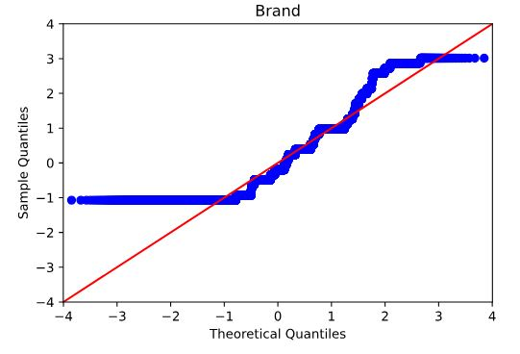
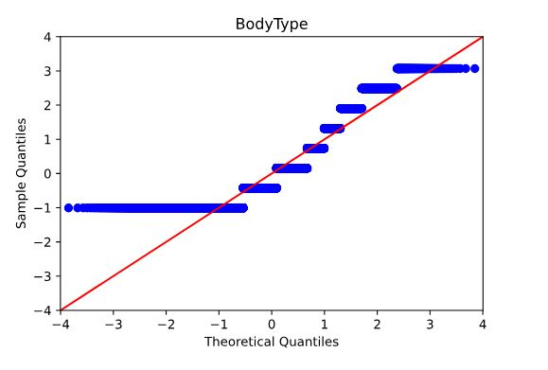
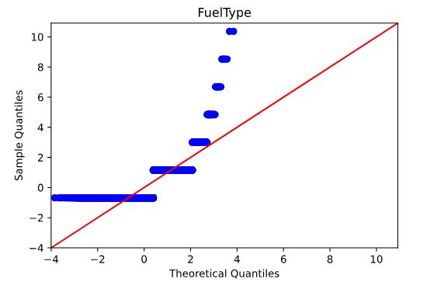
EDA

Slide 7
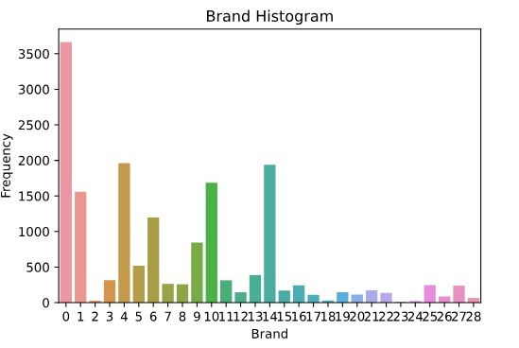
Brand

Slide 8
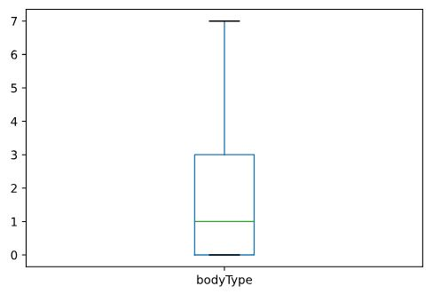
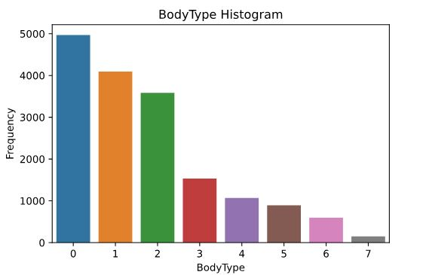
BodyType

Slide 9
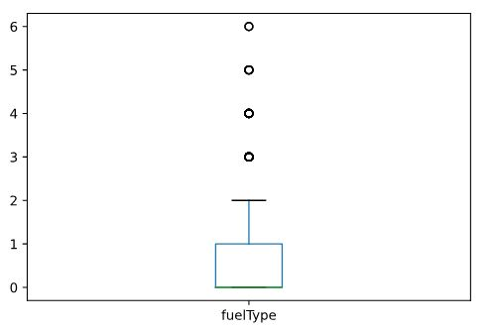
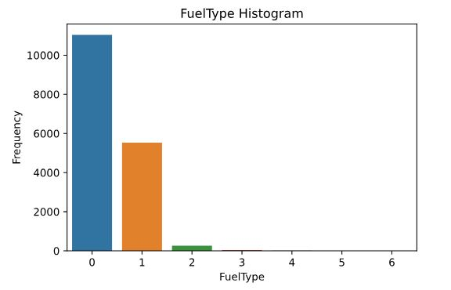
FuelType

Slide 10
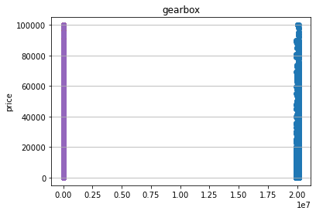
Gearbox

Slide 11
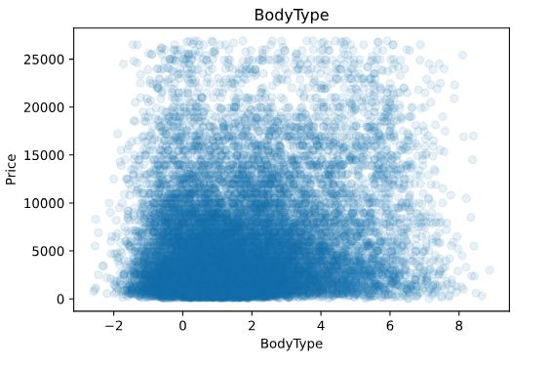
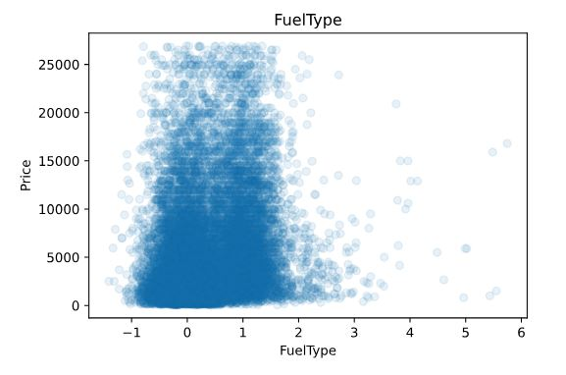
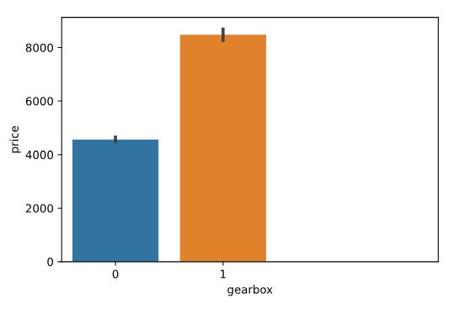
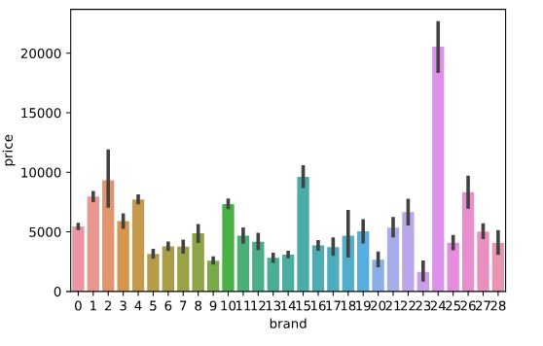
Visualization

Slide 12
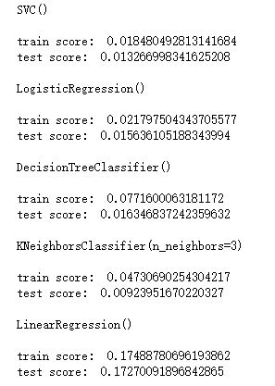
Model Predictions
Model Prediction
  Try 5 models
    Train-Test Split
    Cross Validation
  Summary
Logit Regression has the highest accuracy. using Train-Test Split.
Notes:
6053.366341463392

Slide 13
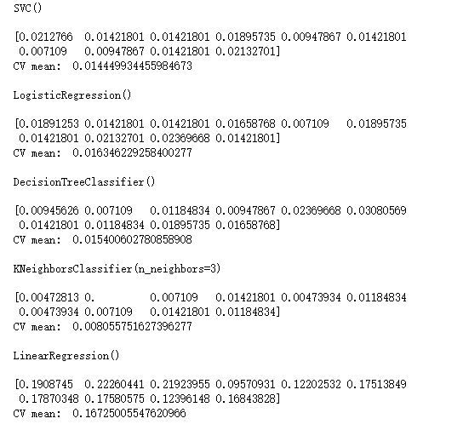
Model Predictions
Model Prediction
  Try 5 models
    Train-Test Split
    Cross Validation
  Summary
Linear Regression Has the Highest Accuracy.
Notes:
6053.366341463392

Slide 14
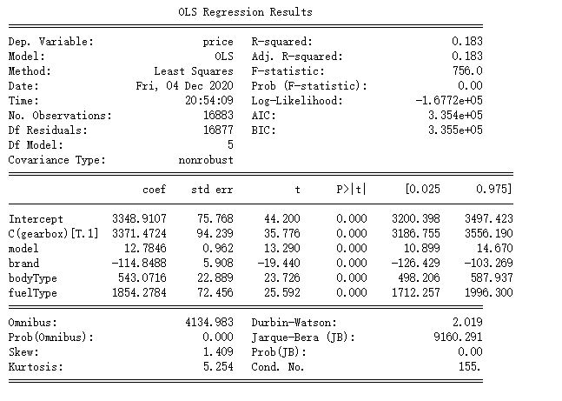
Logit Model

Slide 15
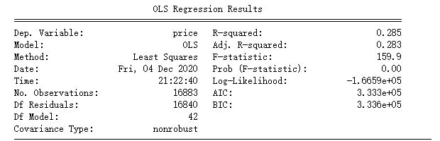
Linear Model
The Predicted Price is 5423.949454933

Slide 16
Q2: Car Damage Factors Impact
    Vehicle’s milage, Engine power and whether the Car has been damaged or not
    EDA
    Model
    Prediction

Slide 17
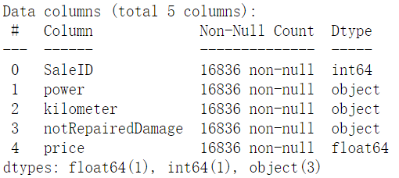
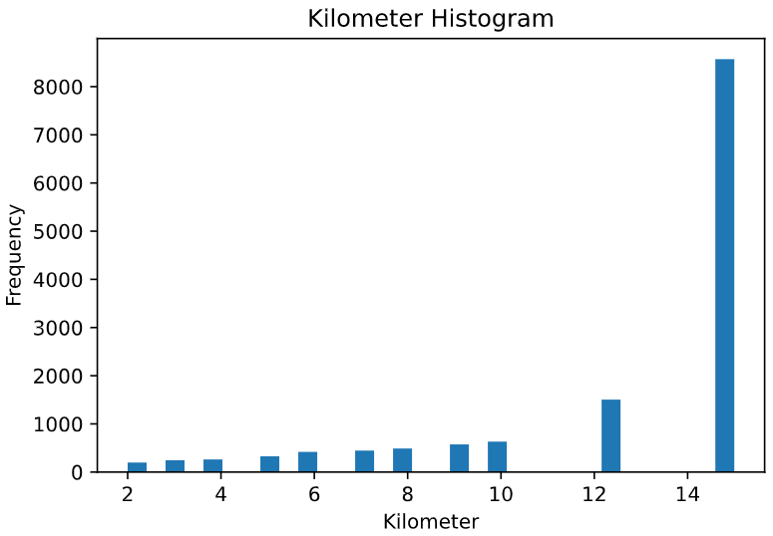
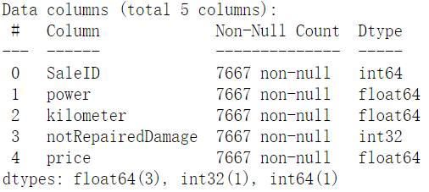
EDA
Before
Data Processing
  Drop NA
  Change Type
  Drop Outerliers
After

Slide 18
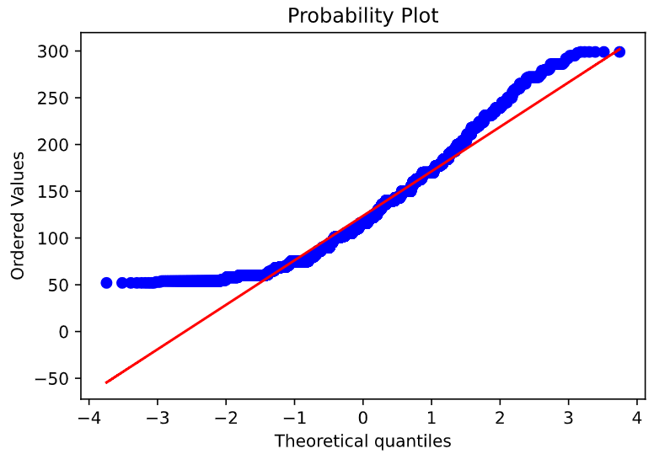
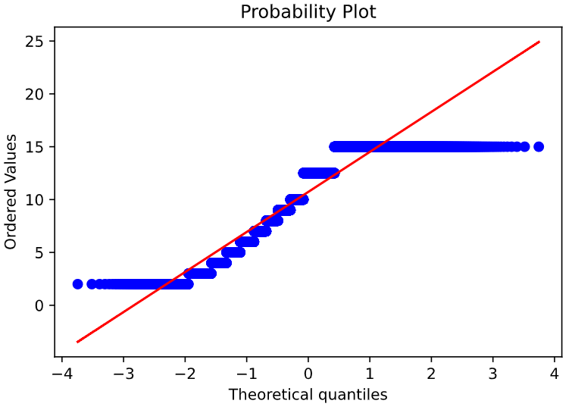
EDA
Power
Model Check
  Noramlity
    QQ Plot
    Histogram
    Boxplot
Kilometer

Slide 19
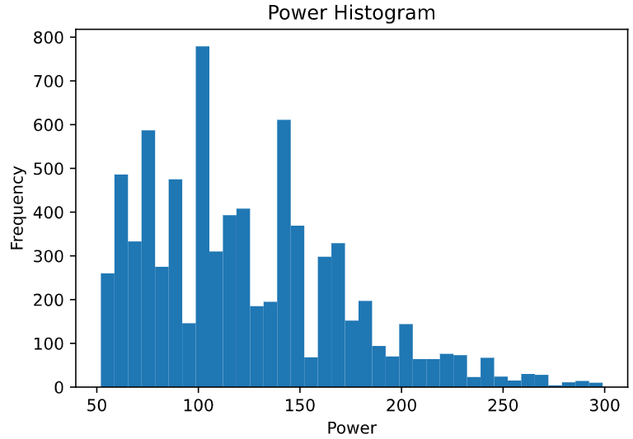
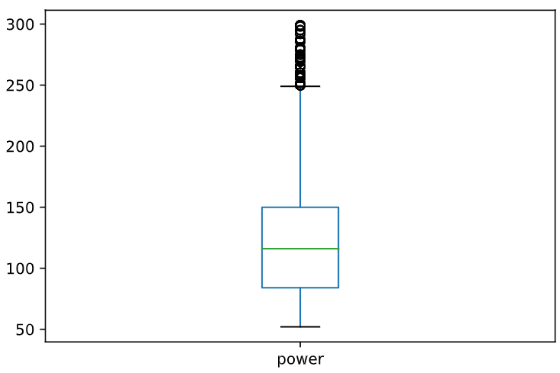
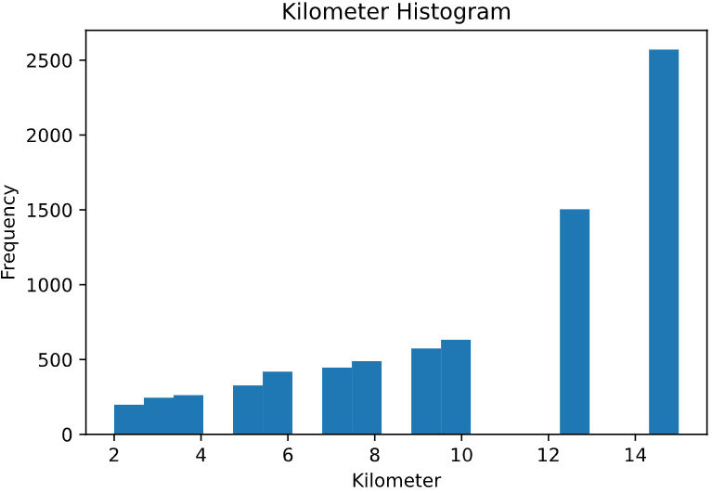
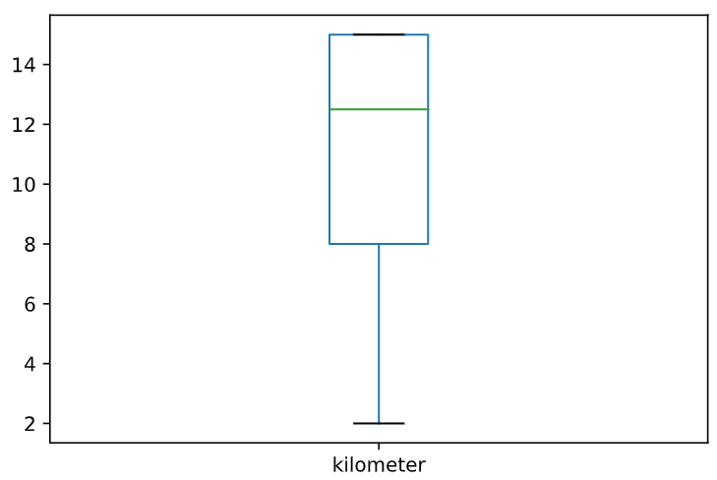
EDA
Histogram
Boxplot

Slide 20
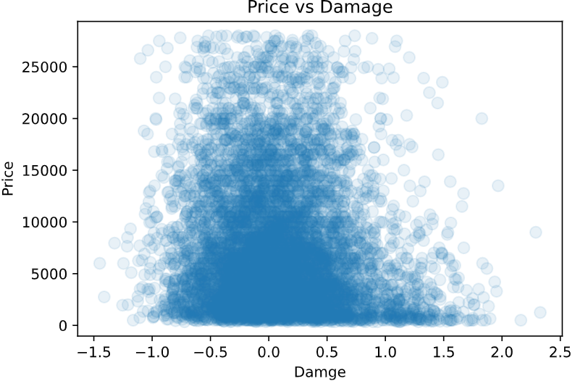
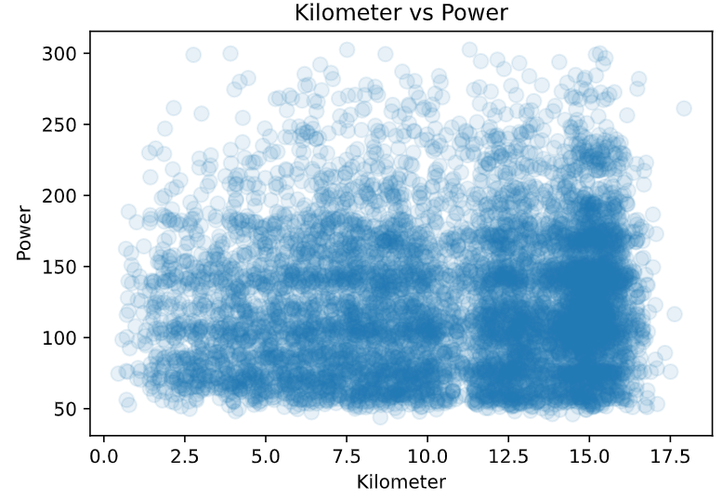
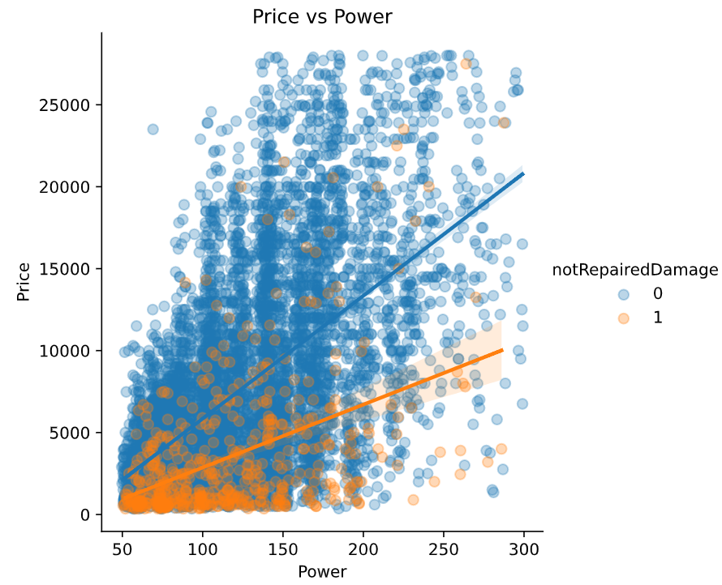
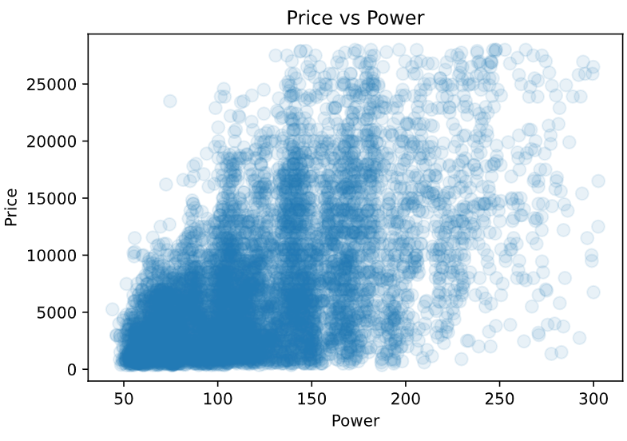
Visualization

Slide 21
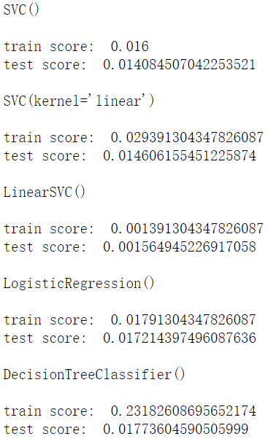
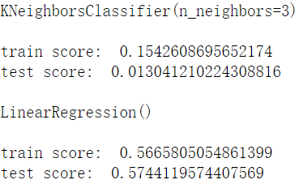
Model Predictions
Model Prediction
  Try seven models
    Train-Test Split
    Cross Validation
  Summary
Linear Regression has the highest accuracy.
Notes:
6053.366341463392

Slide 22
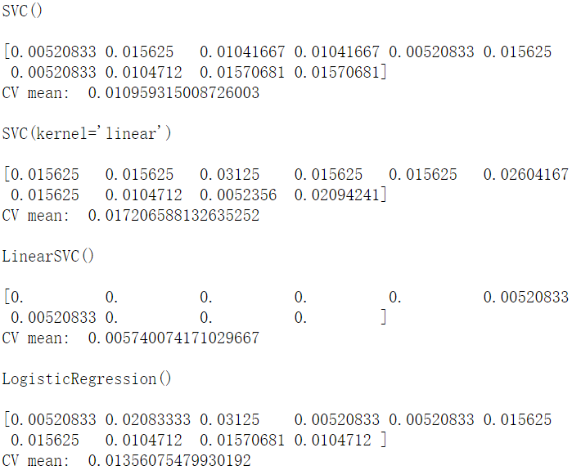
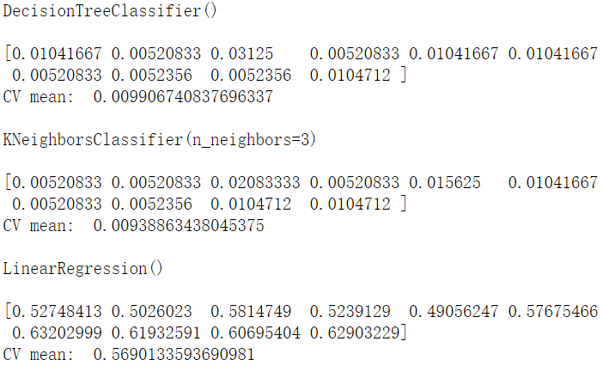
Model Predictions
Model Prediction
  Try seven models
    Train-Test Split
    Cross Validation
Cross Validation gets the same result.
Notes:
6053.366341463392

Slide 23
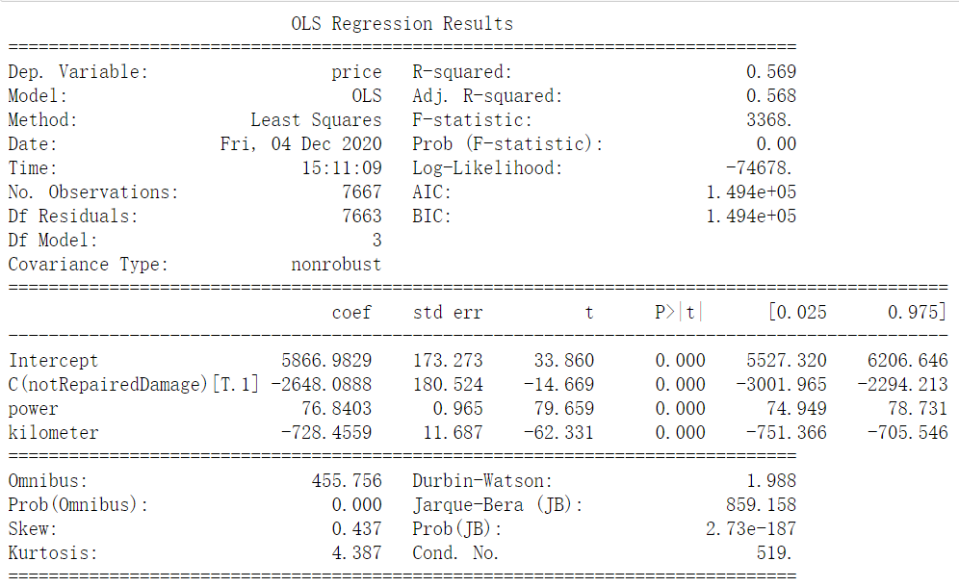
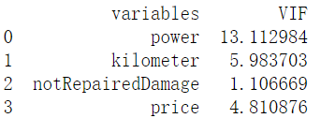
Model Summary
Our predicted price will be
7366.5488457
in this model.
Notes:
6053.366341463392

Slide 24
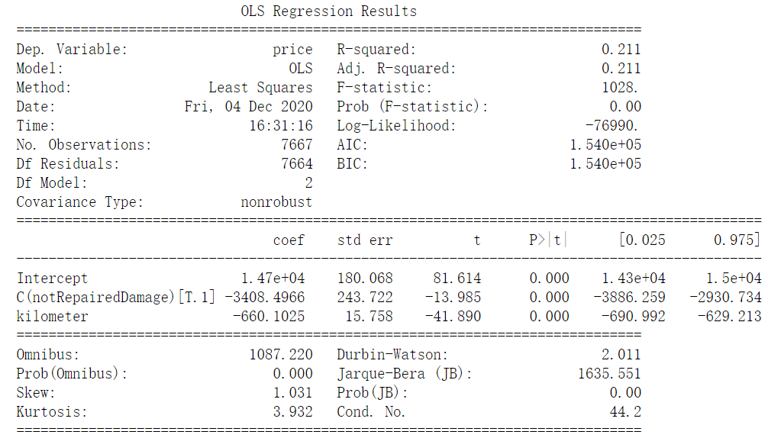
Model Summary
Our predicted price will be
7366.5488457
in this model.

Slide 25
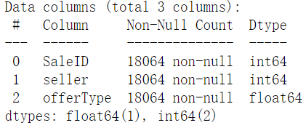
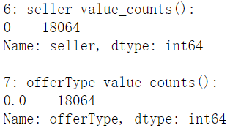
Q3: Market Behavior Impact
    Vehicle’s seller and offerType
    After sampling and data processing,
    These two variables only have 0,
    so we dropped this question.

Slide 26
Suggestions on Buying a Used Vehicle
Recommendations
Cautions

Slide 27
Conclusion
    Conclusion for SMART question 1
    Conclusion for SMART question 2
    Conclusion for SMART question 3

